Slide 1
PYSINDY PREBIOTIC CHEMISTRY SPRING 2022
AYAN DEEP HAZRA

Slide 2
SAMPLING CONSIDERATIONS
Realistic Lab Sampling Rate -> Once every 30 minutes or 48 times a day.
Over 2 days that would be 96 samples. Rounded to 100 for simplicity.

Slide 3
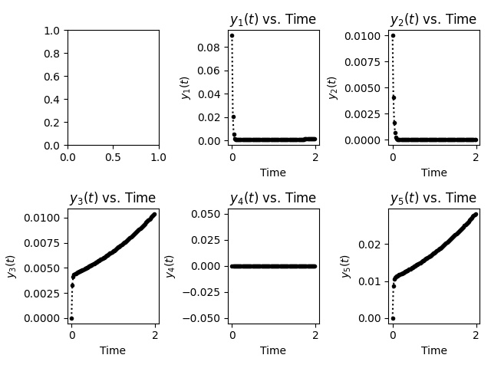
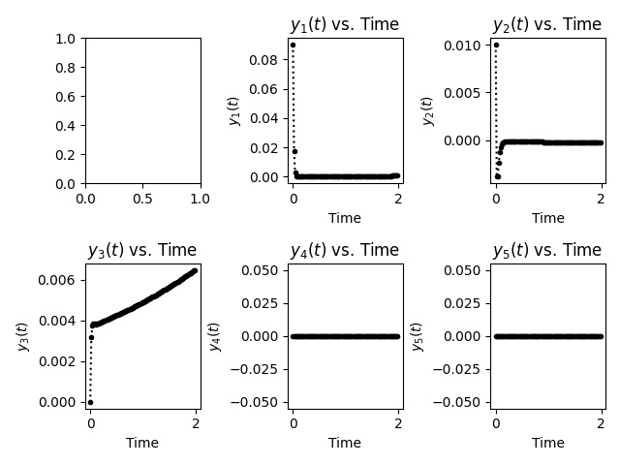
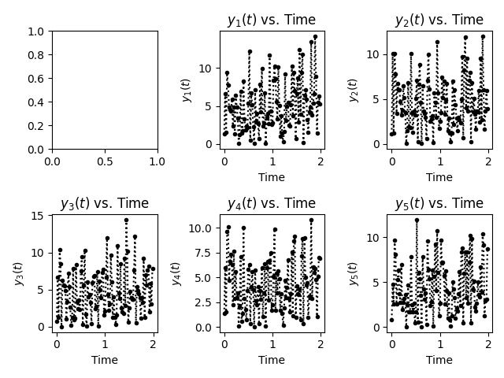
90-10 @ 0.01 s.d.
100 timepoints
Noise that was added to the data
No-Noise Recovered Model
Noise Recovered Model

Slide 4
TRYING WITH MORE TIMEPOINTS

Slide 5
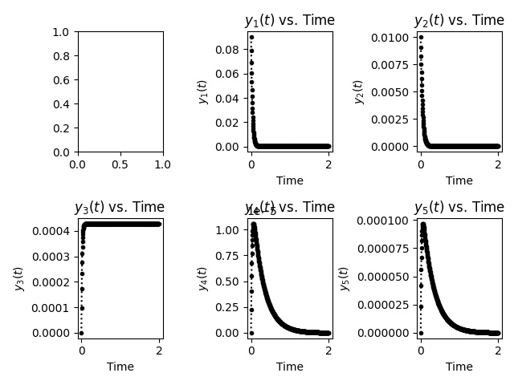
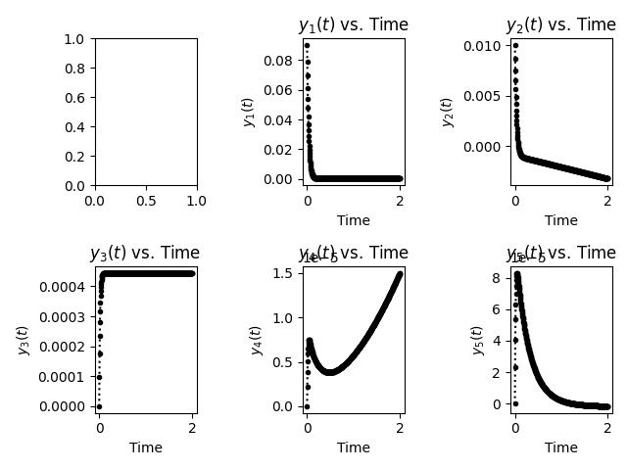
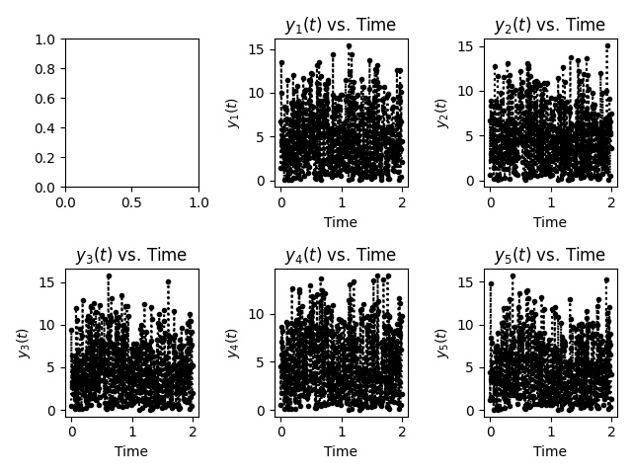
90-10 @ 0.01 s.d.
500 timepoints
Noise that was added to the data
No-Noise Recovered Model
Noise Recovered Model

Slide 6
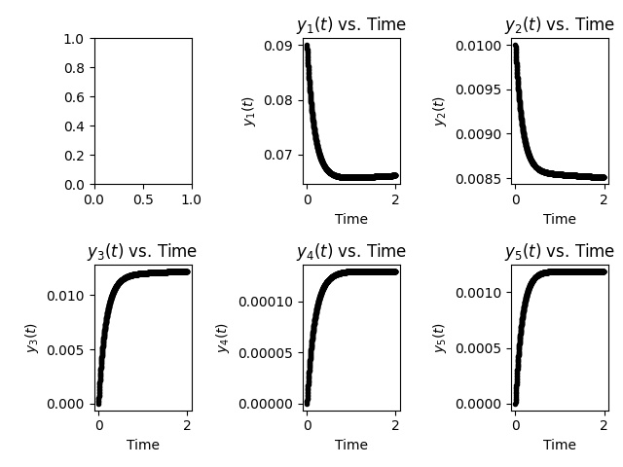

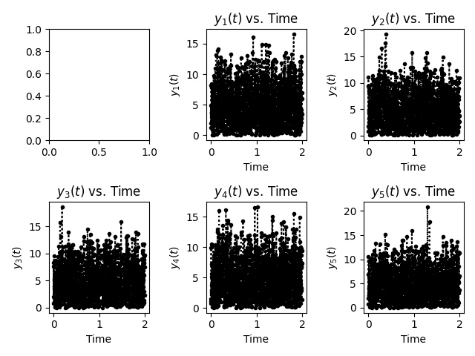
90-10 @ 0.01 s.d.
1000 timepoints
Noise that was added to the data
No-Noise Recovered Model
Noise Recovered Model

Slide 7
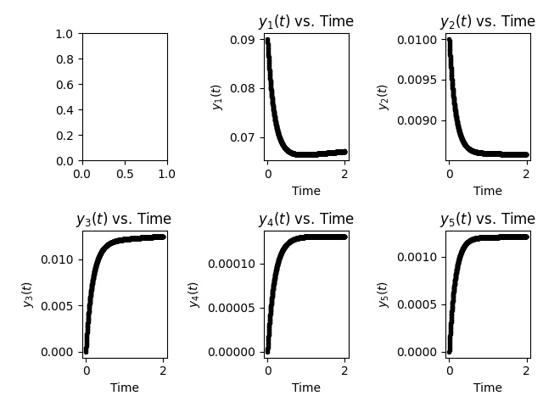

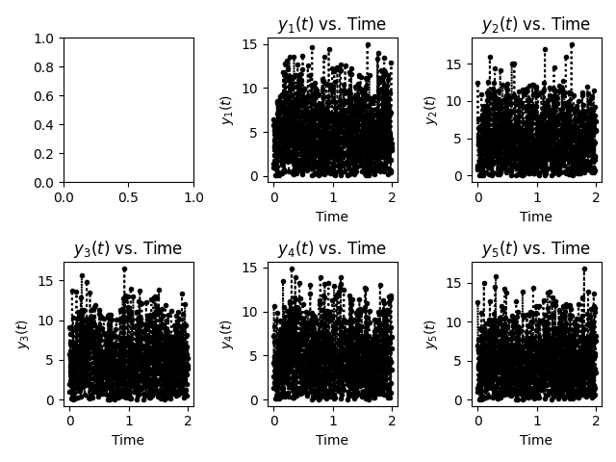
90-10 @ 0.01 s.d.
860 timepoints
Noise that was added to the data
No-Noise Recovered Model
Noise Recovered Model

Slide 8
MASS BALANCE CALCULATIONS

Slide 9
MASS BALANCE
Calculated the mass balance for every time step.
Compared each value to the expected mass balance of the initial conditions.
Error was calculated at each point, using the difference / expected formula.
The error at each timestep was averaged out, and a score was reported for both the No-Noise Model and the Noise Model.

Slide 10
